Slide 1


Rockbuster
Strategy Analysis
Magdalena Hofbauer 20 August 2024

Slide 2
Background
Rockbuster Stealth LLC, once a global leader in movie rentals, is transitioning to an online video rental service. To counter competition from streaming giants like Netflix and Amazon Prime, the company plans to utilize its existing movie licenses to stay competitive in the evolving market.

Slide 3
Key Questions &
Objectives
Which movie contributed the most/the least to revenue gain?
What was the average rental duration for all videos?
Do sales figures vary between geographic regions?
Which countries are Rockbuster customers based in?
Where are customers with a high lifetime value based?
Objective: Use data driven insights for 2020 company strategy

Slide 4
Summary Statistics
Average Rental Duration: 5 Days
Most common Movie Rating: PG13
Total Revenue: 61.312 $
Highest grossing Genre: Sports
599 Customers in 108 Countries

Slide 5
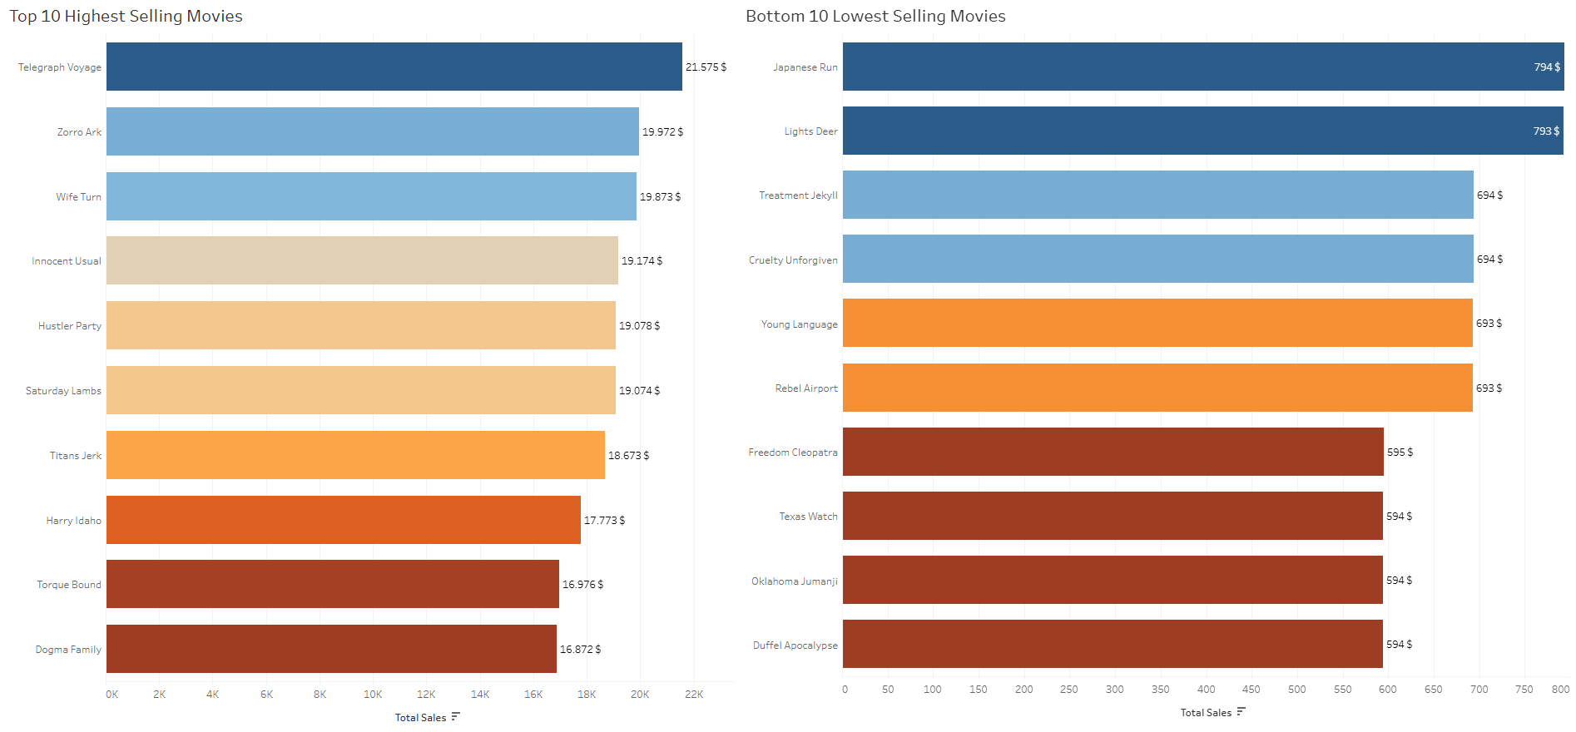
What movies contributed most/least to revenue gain?

Slide 6
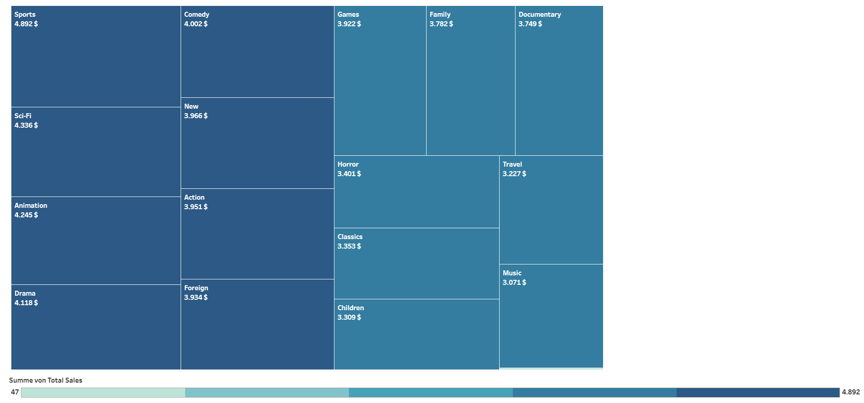
Most popular genres
Highest Revenue Genre was “Sports” with
4.892 $

Slide 7
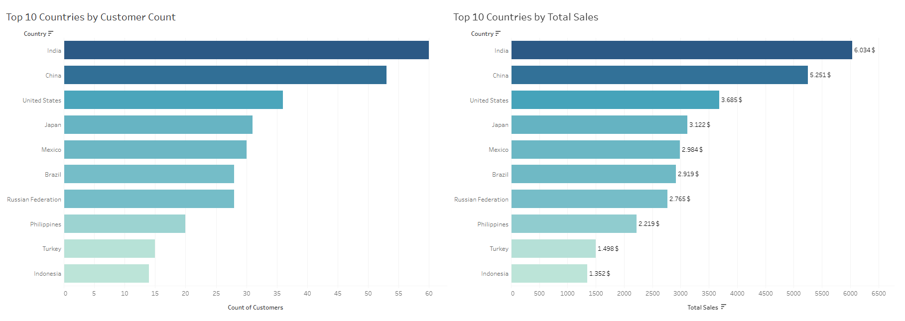
Do sales figures vary between geographic regions?
Top 5 countries: India, China, United States, Japan, Mexico

Slide 8
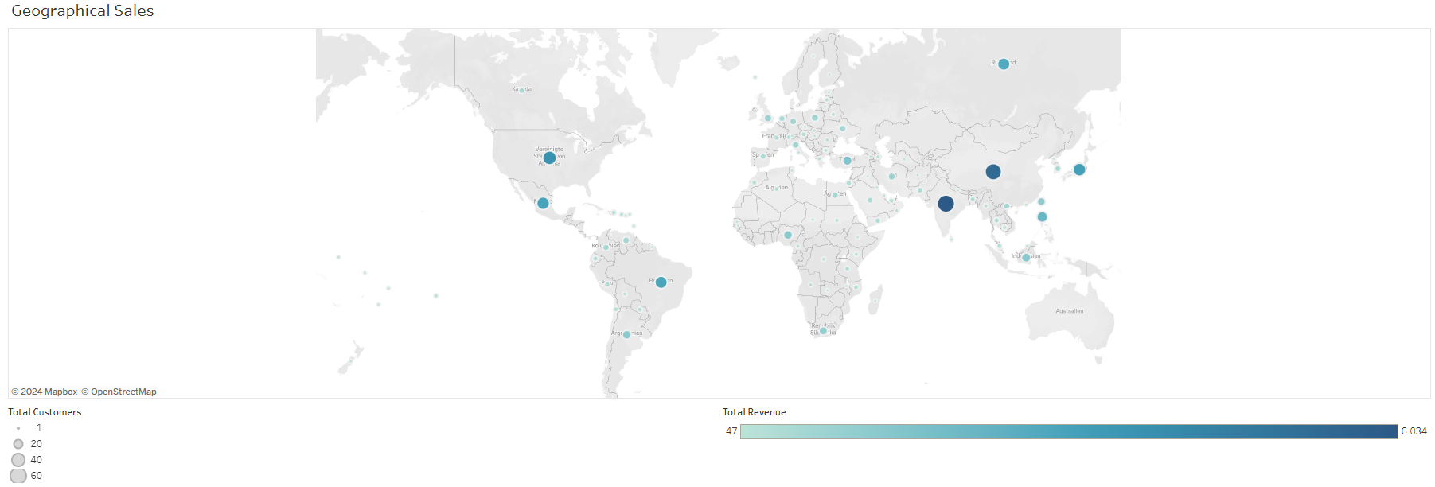
Which countries are Rockbuster customers based in?
Top 5 countries: India, China, United States, Japan, Mexico

Slide 9
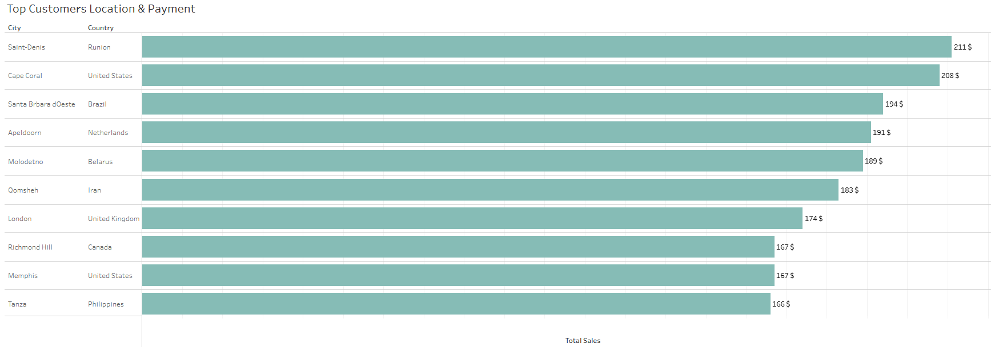
Where are customers with a high lifetime value based?

Slide 10
Recommendations
Focus on Key Markets: Concentrate the marketing efforts where customers are most active. By identifying the regions with the highest engagement, create campaigns that truly resonate with the people who love this service the most.
Personalize the Experience: Develop tailored marketing strategies and loyalty programs that make customers feel valued. For those who might be on the fence, targeted promotions can help bring them on board and keep them coming back.
Promote What They Love: Customers have shown a clear preference for certain genres like Action, Comedy, and Thriller. By focusing on these popular categories, can give the audience more of what they enjoy, leading to increased satisfaction and more frequent rentals.
Keep It Fresh: Featuring a mix of new releases and beloved movies from the last decade will help attract a wide range of viewers and keep them engaged with fresh options.
Cater to Different Tastes: Not everyone has the same amount of time to watch a movie. Offer films of various lengths, to cater to different viewing habits and make sure there's something for everyone, whether they have a couple of hours or just a quick break

Slide 11
Thank you
Click here for more Information

